Slide 1


CODE BASICS
Challenge #14
Telecom & Streaming Services
Presented by
Poojitha Kolli

Slide 2
INTRODUCTION
Lio, a leading telecom provider in India, is planning to merge with Jotstar, a well-known OTT platform.
This merger aims to combine LioCinema’s large subscriber base with Jotstar’s diverse content library to create a top streaming service in India.
To make informed decisions, Lio’s management wants to analyze data from both platforms, focusing on subscriber trends, content consumption, inactivity patterns, and subscription changes over the past year (January – November 2024).
As the data analyst, my role is to study the provided datasets, identify key insights, and present recommendations.
This presentation will highlight important findings and suggest strategies to make the merger successful.

Slide 3
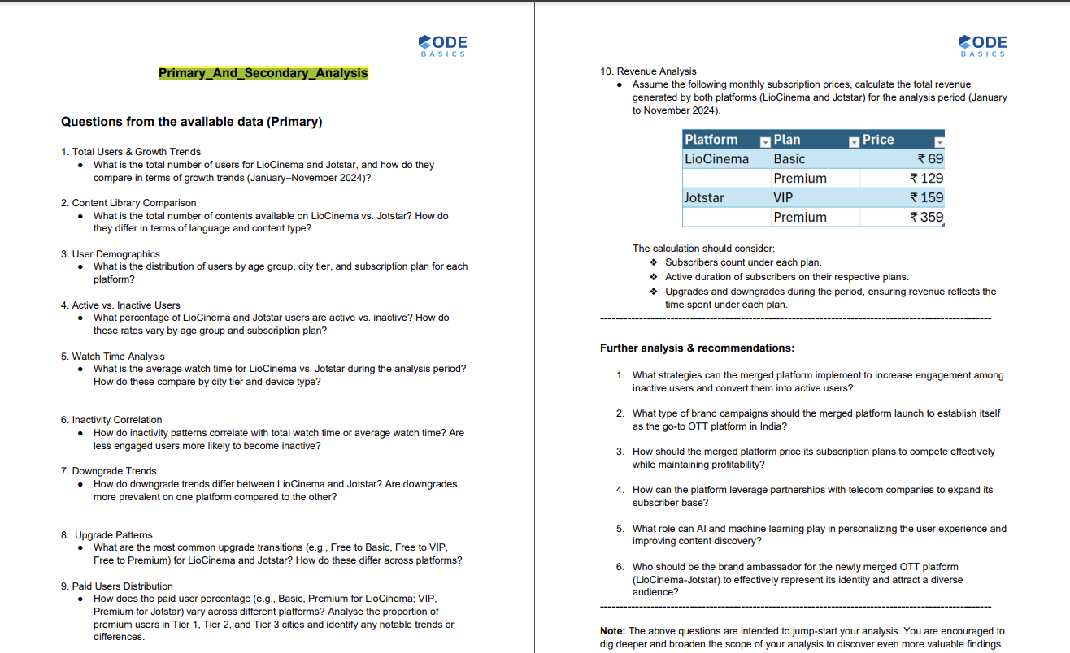
Primary And Secondary Analysis

Slide 4
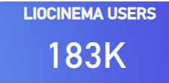
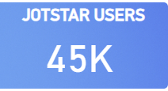
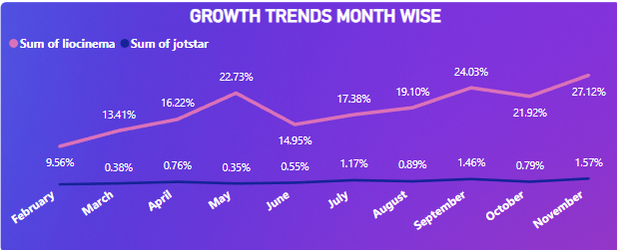
1. Total Users & Growth Trends
What is the total number of users for LioCinema and Jotstar, and how do they compare in terms of growth trends (January–November 2024)?
Key Insights:
LioCinema: 183K users 📈
Jotstar: 45K users 📉
LioCinema has a significantly larger user base, capturing a broader market presence.
Growth Trends:
LioCinema shows steady and strong growth, peaking at 27.12% in November 2024.
Jotstar, despite having a smaller user base, has maintained a consistent but slower growth rate, staying below 2% growth each month.

Slide 5
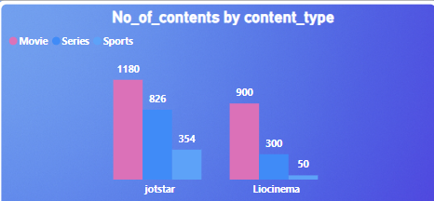
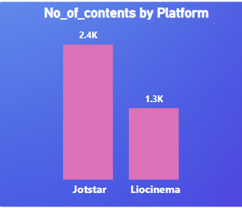
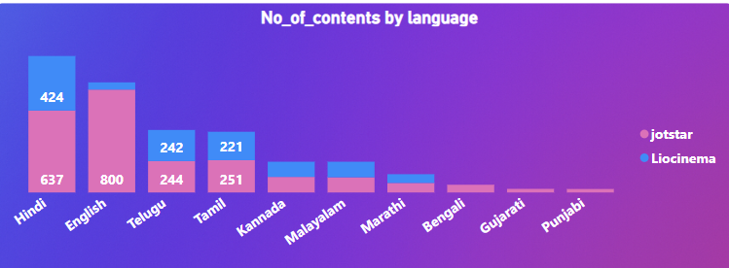
2. Content Library Comparison
What is the total number of contents available on LioCinema vs. Jotstar? How do they differ in terms of language and content type?
Key Insights:
Jotstar has a larger content library compared to LioCinema, offering a wider selection of movies and series.
Both LioCinema and Jotstar have a wide range of movies and series, with a strong collection in Hindi, Tamil, and Telugu.

Slide 6
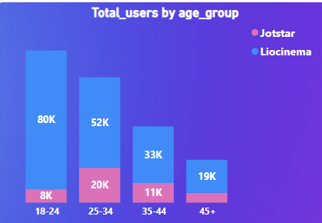
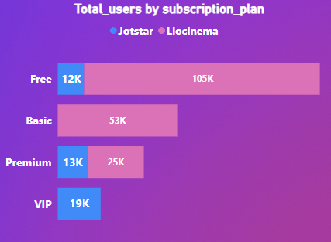
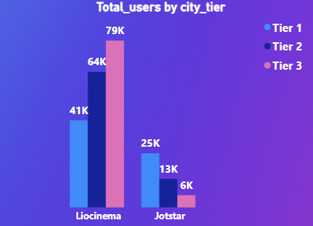
3. User Demographics
What is the distribution of users by age group, city tier, and subscription plan for each platform?
LioCinema has a higher user base among the 18-24 age group, while Jotstar is more popular among users aged 25-34.
In terms of subscription plans, free users dominate LioCinema, whereas VIP subscribers are more common on Jotstar.
Additionally, LioCinema has a stronger presence in Tier-3 cities, while Jotstar is preferred by users in Tier-1 cities.

Slide 7
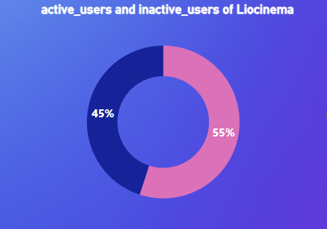
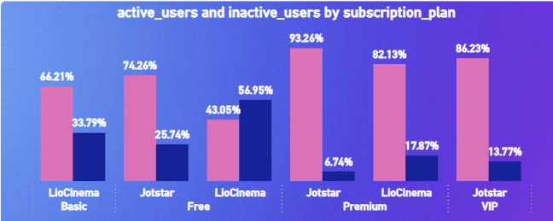
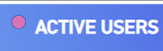

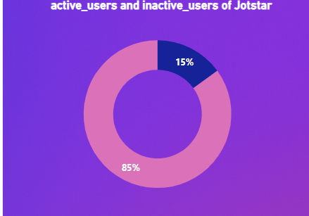
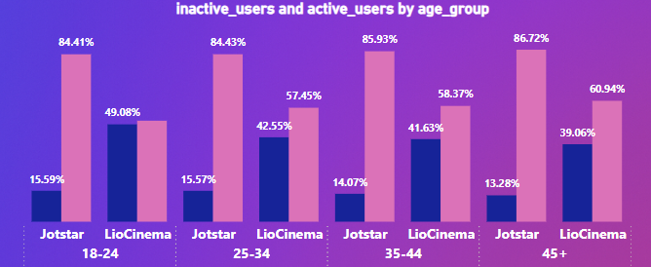
4. Active vs. Inactive Users
What percentage of LioCinema and Jotstar users are active vs. inactive? How do these rates vary by age group and subscription plan?

Slide 8
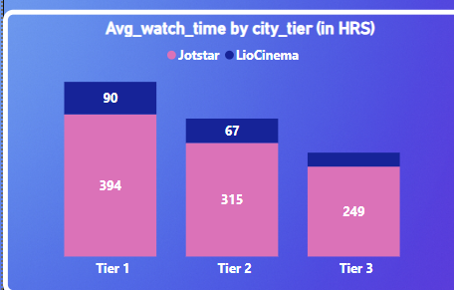
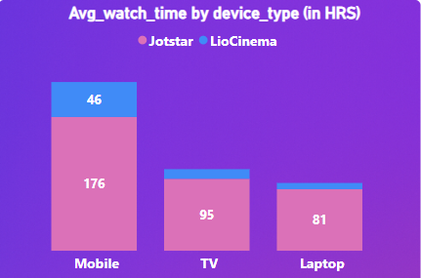
5. Watch Time Analysis
What is the average watch time for LioCinema vs. Jotstar during the analysis period? How do these compare by city tier and device type?
Tier-1 city users recorded the highest watch time across both platforms, indicating strong engagement from urban audiences.
In terms of device preference, mobile devices accounted for the majority of total watch time, highlighting the growing trend of on-the-go streaming.

Slide 9
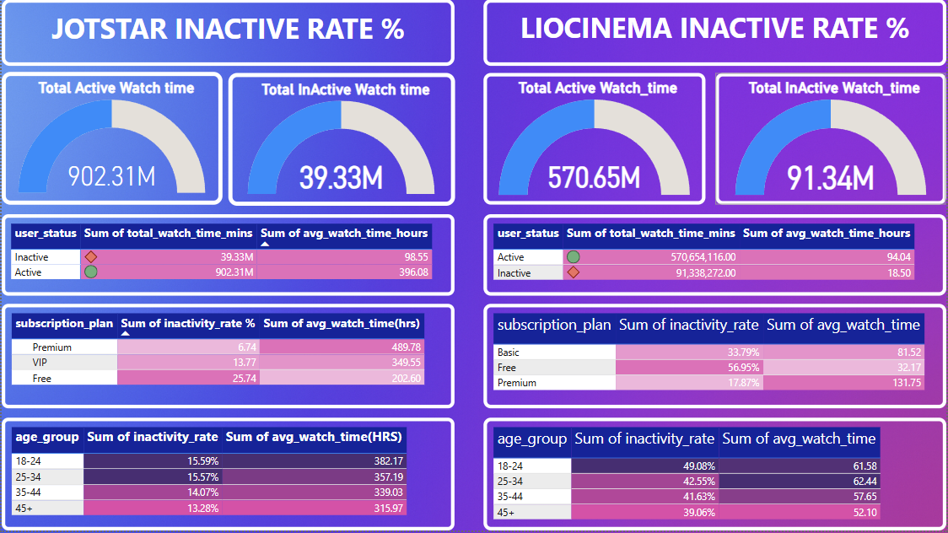
6. Inactivity Correlation
How do inactivity patterns correlate with total watch time or average watch time? Are less engaged users more likely to become inactive?

Slide 10
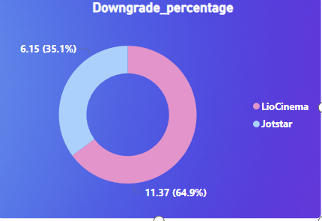
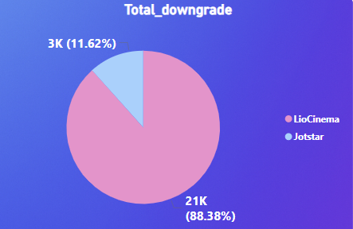
7. Downgrade Trends
How do downgrade trends differ between LioCinema and Jotstar? Are downgrades more prevalent on one platform compared to the other?
LioCinema experiences a higher rate of downgrades compared to Jotstar, indicating that more users are shifting from paid to free plans. This could be due to pricing concerns, lack of premium content, or user engagement factors. In contrast, Jotstar has a lower downgrade rate, suggesting better retention of its VIP subscribers.

Slide 11
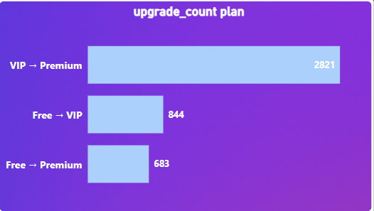
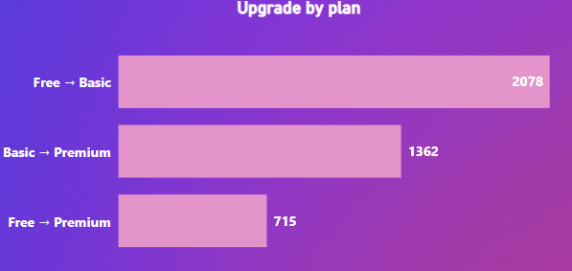
8. Upgrade Patterns
What are the most common upgrade transitions (e.g., Free to Basic, Free to VIP, Free to Premium) for LioCinema and Jotstar? How do these differ across platforms?
Jotstar
Liocinema
Jotstar sees a higher number of upgrades to the Premium plan, indicating strong demand for its top-tier content. In contrast, LioCinema shows a more balanced upgrade pattern, with users transitioning almost equally from Free to Basic and Free to Premium.

Slide 12
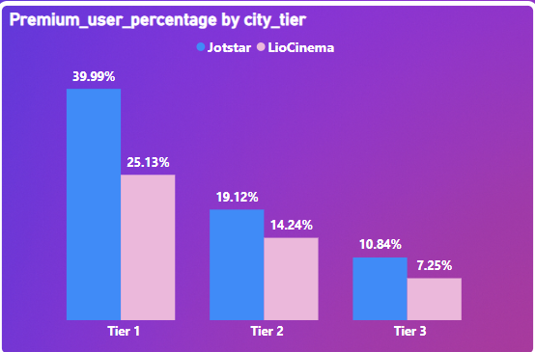
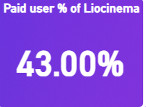
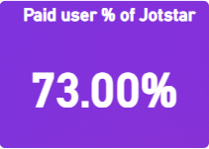
9. Paid Users Distribution
How does the paid user percentage (e.g., Basic, Premium for LioCinema; VIP, Premium for Jotstar) vary across different platforms? Analyse the proportion of premium users in Tier 1, Tier 2, and Tier 3 cities and identify any notable trends or differences.
Jotstar has a higher percentage of paid users compared to LioCinema, with most of its VIP and Premium subscribers coming from Tier-1 cities.
This suggests that Jotstar appeals more to urban audiences willing to pay for premium content.
In contrast, LioCinema has a lower proportion of paid users, indicating a stronger reliance on its free-tier audience, particularly in Tier-2 and Tier-3 cities.

Slide 13
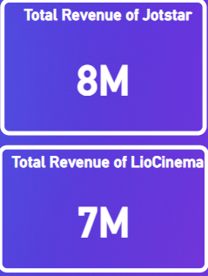
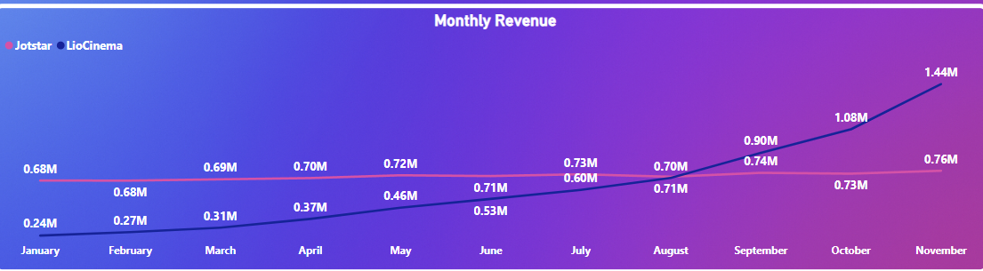
10. Revenue Analysis
Assume the following monthly subscription prices, calculate the total revenue generated by both platforms (LioCinema and Jotstar) for the analysis period (January to November 2024).
Jotstar has consistently maintained steady revenue growth throughout the year, reflecting a stable and loyal paid subscriber base.
LioCinema, on the other hand, experienced significant revenue growth, surging from 0.2M in January to 1.4M in November, indicating a rapid increase in paid user adoption.
Despite LioCinema’s rapid growth, Jotstar’s total revenue remains higher, driven by its strong base of VIP and Premium subscribers.

Slide 14
Further analysis & recommendations:
1.Increasing Engagement Among Inactive Users :
Personalized Re-engagement Campaigns: Use AI-driven recommendations to send personalized content suggestions via emails, notifications, and WhatsApp.
Gamification & Rewards: Implement loyalty programs with points for watching content, reviewing, and referring friends.
Limited Free Access: Offer time-limited free access to premium content to encourage engagement.
Exclusive Live Events & Interactivity: Host live Q&A sessions with celebrities, interactive quizzes, and watch parties.
Localized Content & Regional Focus: Target inactive users with regional content that aligns with their preferences.

Slide 15
2. Brand Campaigns to Establish Market Leadership:
“One Platform, Endless Entertainment” Campaign: Highlight that LioCinema + Jotstar brings together sports, Bollywood, Hollywood, and regional content under one service.
Star-Powered Ads with Bollywood, sports, and digital influencers.
Festival & Sports Promotions with discounts during IPL, Diwali, etc.
Regional Focus: Create city-specific and language-based campaigns to attract regional audiences.

Slide 16
3. Subscription Pricing Strategy
Student Discount Plans: Target college students with 50% off on first three months.
Bundled Offers: Discounted annual subscriptions + family plans (up to 5 members) to encourage bulk purchases.
Flash Sales & Festive Discounts: Special pricing during Diwali, IPL season, and other high-traffic periods.
Regional Pricing: Cheaper subscription rates in non-metro cities to attract regional viewers.
Sports-Only Plan: Provide a low-cost sports plan to target cricket and football fans.

Slide 17
4. Leveraging Telecom Partnerships for Expansion
Bundle with Mobile & Broadband Plans: Partner with telecom providers to offer free premium subscriptions with postpaid and broadband plans.
5G Streaming Optimized: Promote buffer-free 4K streaming through 5G connectivity.
Retail Recharge Partnerships: Allow users to subscribe through mobile recharge shops in Tier 2 & Tier 3 cities.
Affordable Data + OTT Bundles: Introduce low-cost mobile data + OTT bundles for users who primarily stream on smartphones.

Slide 18
5. AI & Machine Learning for Personalization & Content Discovery
Hyper-Personalized Recommendations: AI-based algorithms to analyze watch history and suggest relevant content.
Multilingual Voice Search: Users can search for movies, series, or sports in their preferred language using voice commands.
AI-Powered Smart Notifications: Notify users about upcoming live matches, trending content, and personalized recommendations.
Automated Dubbing & Subtitles: AI-driven dubbing and subtitles in regional languages for wider accessibility.
Churn Prediction & Retention Strategies: Identify users likely to cancel and offer special retention offers.

Slide 19
6. Brand Ambassador for the Merged OTT Platform (LioCinema-Jotstar)
Virat Kohli or Rohit Sharma (Sports Appeal): Since sports streaming is a big draw, a top cricketer as the brand face ensures strong engagement.
Allu Arjun (South Superstar): Attracts Telugu, Tamil, Kannada, and Malayalam audiences, expanding regional reach.
Kapil Sharma (Comedy & Mass Appeal): Represents family-friendly entertainment, making the platform more relatable.

Slide 20
THANK YOU

